Slide 1




Algorithms
Saptadeep Pal
saptadeep@ucla.edu
This is a modified version of slides by Dr. John Lee,
Dr. Rani Ghaida,
Dr. Abde Ali Kagalwalla and Dr. Yasmine Badr
A lot of the material is based on
Introduction to Algorithms by Cormen et al.
Variability Expedition

Slide 2
What is an Algorithm?
An algorithm is a well-defined computational procedure that takes an input and produces some output.
It is thus a set of computational steps that transform the input into the output.
Algorithm
INPUT
(problem)
OUTPUT
(solution)

Slide 3
Agenda
What sort of problems are solved with algorithms?
Examples of Algorithms
Search Algorithms
Gale Shapley Stable Marriage Algorithm
Shortest-Path Problem
Efficiency of Algorithms
Sorting Algorithms
Exercise: Bubble Sort
Algorithmic Techniques
Greedy Algorithm
Example: Activity Selection Problem
Mini-project: Traveling Salesman Problem
Research Topics

Slide 4
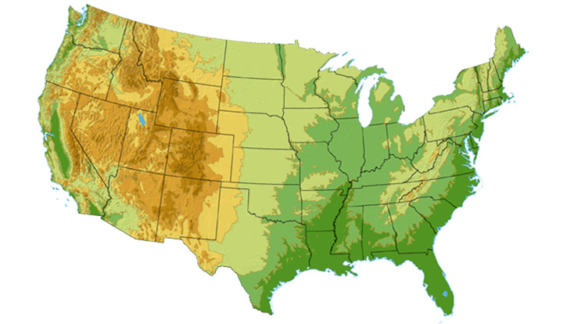









What sort of problems are solved with algorithms?
DS3 (45 Mbps)
OC3 (155 Mbps)
OC12 (622 Mbps)
OC48 (2.4 Gbps)
Seattle
Tacoma
Stockton
Cheyenne
Chicago
New York
Pennsauken
Relay
San Jose
Kansas City
Roachdale
Wash. DC
Anaheim
Atlanta
Fort Worth
Orlando
Internet - Manage and manipulate data
E.g., (1) search engines, (2) finding good routes on which data will travel

Slide 5
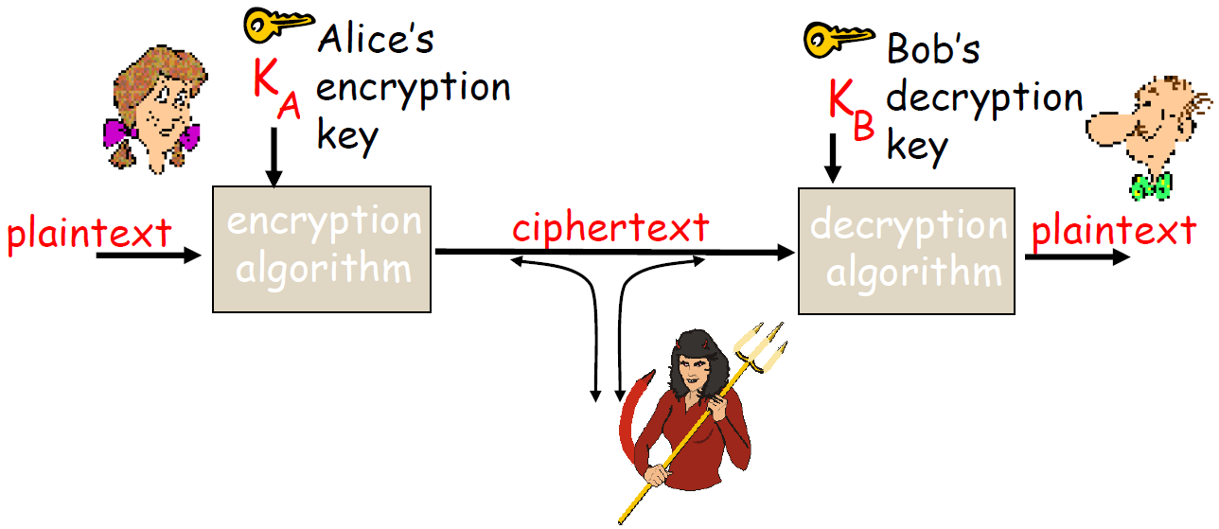
What sort of problems are solved with algorithms?
Data security – cryptography
Encryption algorithm → computational steps to transform plaintext to ciphertext
Decryption algorithm → computational steps to transform ciphertext back to plaintext

Slide 6
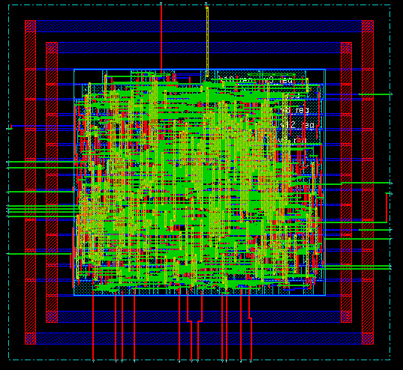
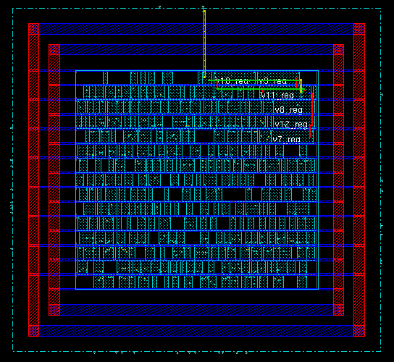
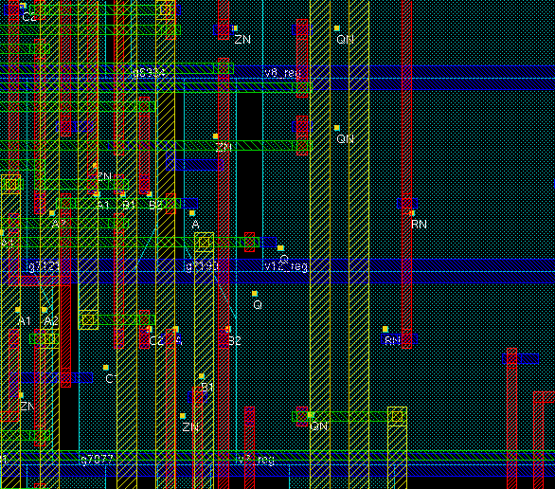
What sort of problems are solved with algorithms?
NanoEletronics – Design Automation
E.g., components placement and routing

Slide 7
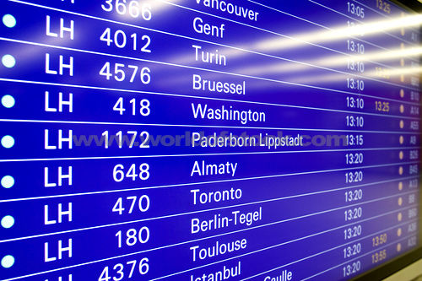
What sort of problems are solved with algorithms?
Scheduling problems
E.g., Flight scheduling
Crew preferences
Airplane types
Weather
Fuel Costs
Delays
From http://www.worldofstock.com/slides/TRA2599.jpg

Slide 8

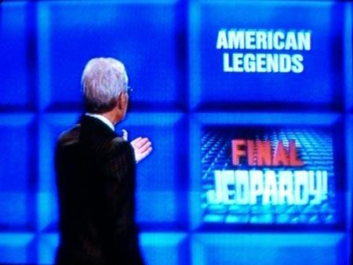
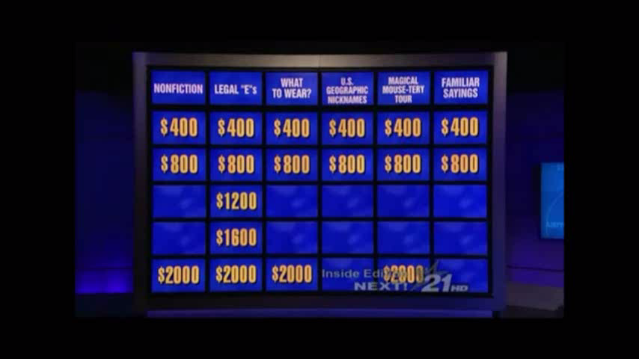

What sort of problems are solved with algorithms?
Artificial Intelligence
E.g., IBM Watson supercomputer beats all-time best Jeopardy! players on Feb 2011
Clue selection
Confidence Threshold for Buzz-in
Daily Double betting
Final Jeopardy betting

Slide 9

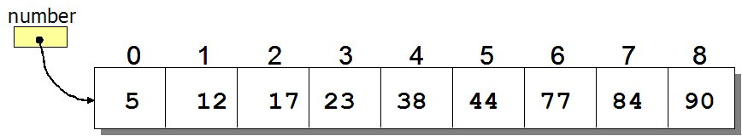
Search Algorithms
How to search for an element in a list?
Sequential search: Go through each element and check if it is the required element
Best case?
Worst case?
What if the list is sorted?
Can we do better?
Source: http://www.spinachandyoga.com/how-to-deal-with-a-long-to-do-list-with-zen/
Source: http://www.csit.parkland.edu/~mbrandyberry/CS1Java/Lessons/Lesson27/BinarySearch.htm

Slide 10
Search Algorithms
How to search for an element x in a list?
Sequential search: Go through each element and check if it is the the required element
Best case?
Worst case?
What if the list is sorted?
Can we do better?
YES
BINARY SEARCH
Source: http://www.spinachandyoga.com/how-to-deal-with-a-long-to-do-list-with-zen/

Slide 11
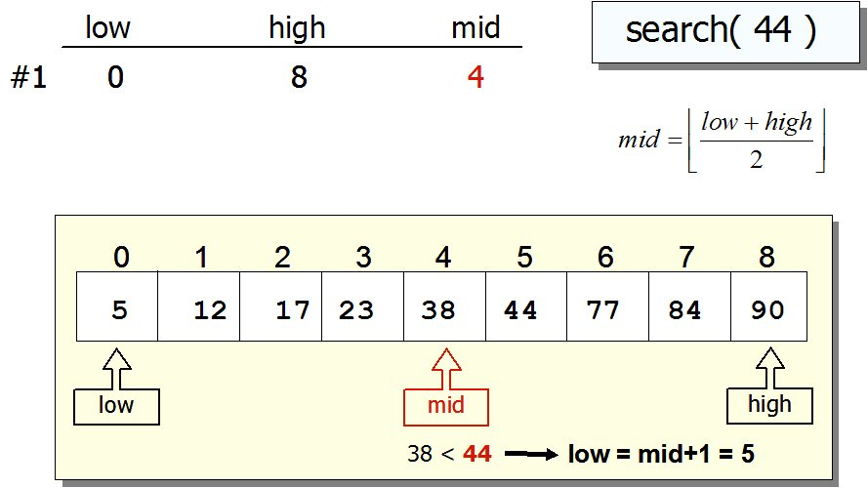
Search Algorithms: Binary Search
If list is sorted:
Split list into two halves. If x is greater than element in the middle then discard the left half. Otherwise discard the right half. Repeat until you find x.
Source: http://www.csit.parkland.edu/~mbrandyberry/CS1Java/Lessons/Lesson27/BinarySearch.htm

Slide 12

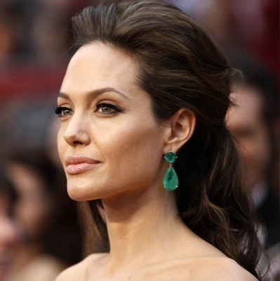



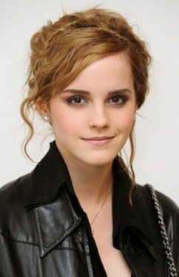

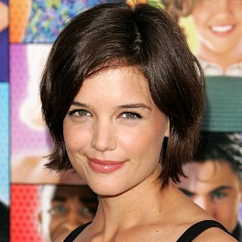
Example: Stable Marriage Problem
Input:
Men, Women, Preferences
Algorithm
Output:
1- All married
2- Stable marriages (i.e., no one prefers someone else who also prefers them

Slide 13
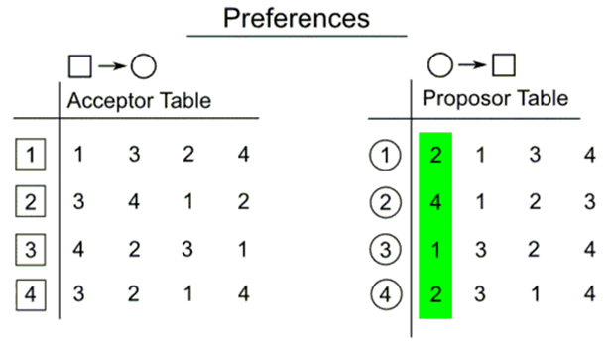
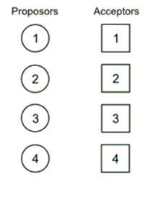
Example: Stable Marriage Problem
Algorithm to solve this?

Slide 14
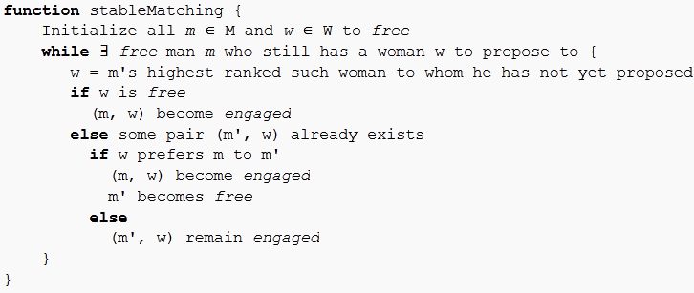
Gale Shapley Stable Marriage Algorithm
In each round, unengaged man "proposes" to the most-preferred woman to whom he has not yet proposed
Each woman then considers all her suitors and tells the one she most prefers "Maybe" and all the rest of them "No".
She is then provisionally "engaged" to the suitor she most prefers so far, and that suitor is likewise provisionally engaged to her
Pseudocode

Slide 15
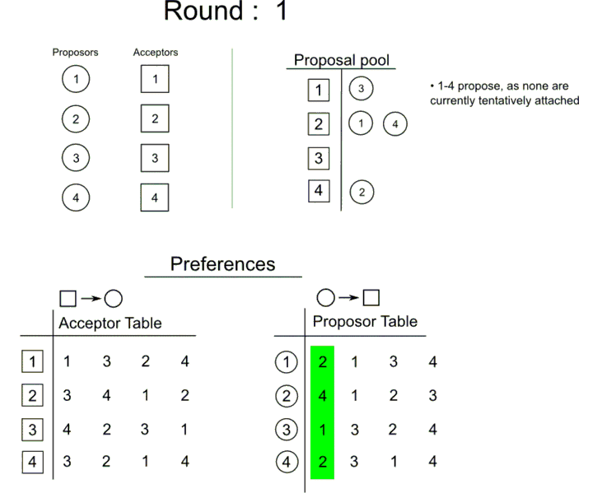
Gale Shapley Stable Marriage Algorithm

Slide 16
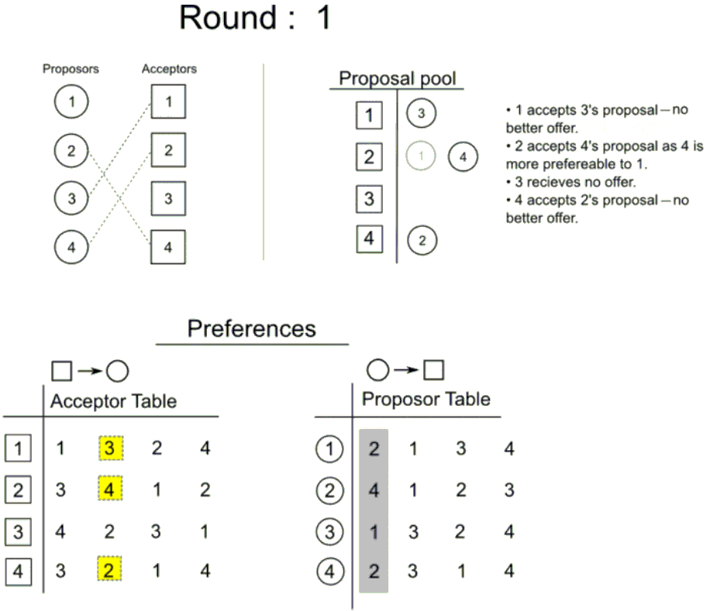
Gale Shapley Stable Marriage Algorithm

Slide 17
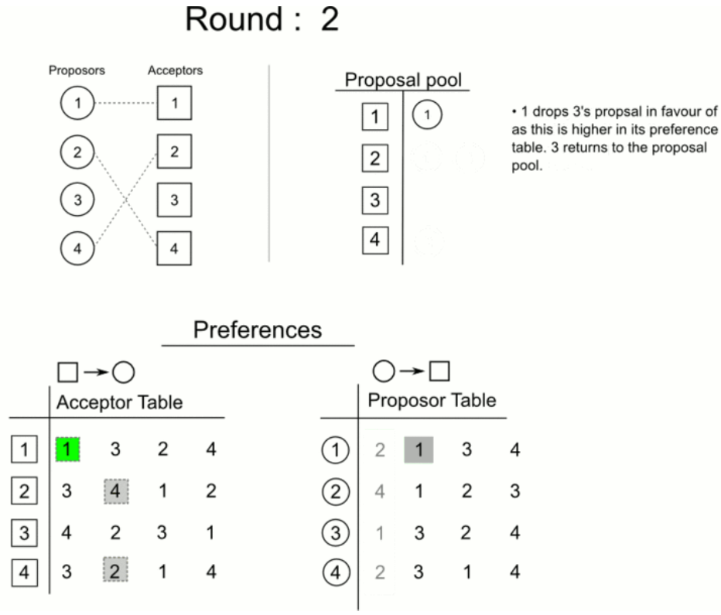
Gale Shapley Stable Marriage Algorithm
1

Slide 18
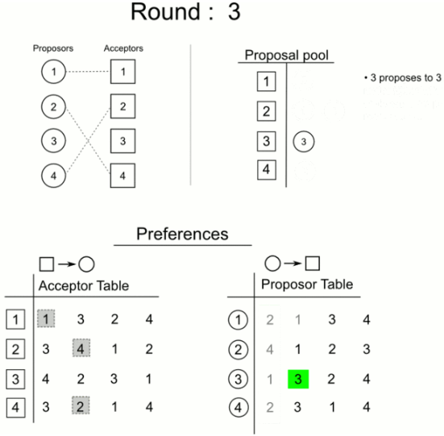
Gale Shapley Stable Marriage Algorithm

Slide 19
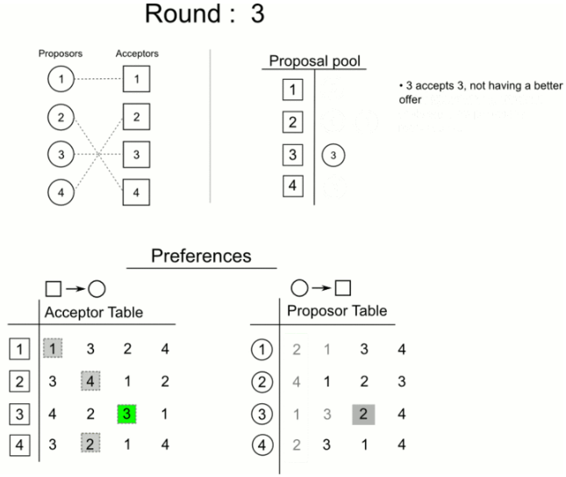
Gale Shapley Stable Marriage Algorithm

Slide 20
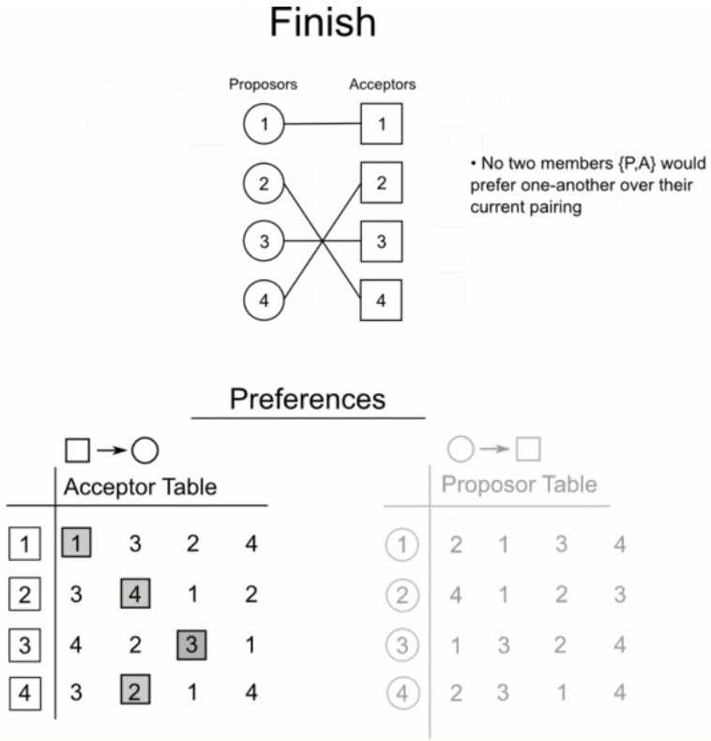
Gale Shapley Stable Marriage Algorithm

Slide 21


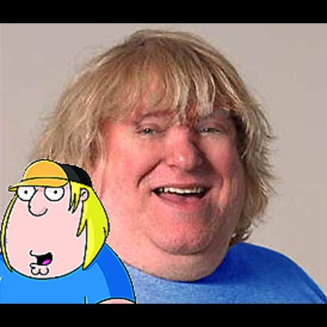

Our Happy Couples!

Slide 22
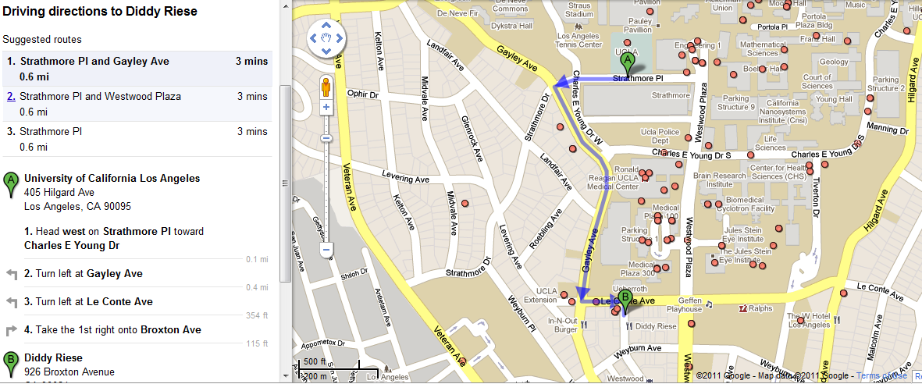
Shortest-Path Problem
Google Maps - determining the fastest route
www.variability.org

Slide 23
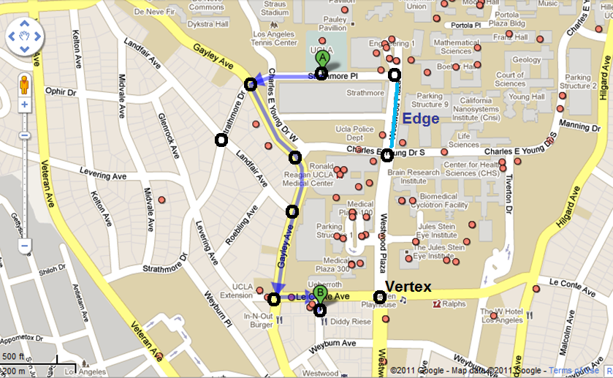
Shortest-Path Problem
Google Maps - determining the fastest route
www.variability.org

Slide 24
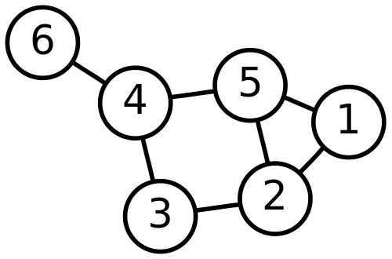
Graph [In Brief]
Set of :
Nodes/vertices
edges connecting the nodes
Edges can be
Undirected: no distinction between the 2 nodes
Directed: has a source and a destination
Node
Edge
Undirected graph
Source: https://en.wikipedia.org/wiki/Graph_theory

Slide 25
Class Activity: Shortest Path Algorithm
Can you come up with an algorithm that solves the shortest path problem?
Work in groups
What is the shortest path from s to t?
Example and Animation are from National University of Singapore
2
24
3
9
s
18
14
6
6
2
30
4
19
11
15
5
5
6
20
16
7
t
44

Slide 26
Dijsktra’s Shortest Path Algorithm
Find shortest path from s to t.
2
24
3
9
s
18
14
6
6
2
30
4
19
11
15
5
5
6
20
16
7
t
44
Example and Animation are from National University of Singapore

Slide 27
Dijsktra’s Shortest Path Algorithm
S = { }
PQ = { s, 2, 3, 4, 5, 6, 7, t }
B = { }
∞
∞
0
2
24
3
9
s
∞
18
14
6
6
2
∞
∞
4
30
19
11
15
5
5
6
20
16
7
t
distance label
44
∞
∞
Example and Animation are from National University of Singapore

Slide 28
Dijsktra’s Shortest Path Algorithm
S = { }
PQ = { s, 2, 3, 4, 5, 6, 7, t }
B = { }
dmin
∞
∞
0
2
24
3
9
s
∞
18
14
6
6
2
∞
∞
30
4
19
11
15
5
5
6
20
16
7
t
distance label
∞
44
∞
Example and Animation are from National University of Singapore

Slide 29
Dijsktra’s Shortest Path Algorithm
S = { s }
PQ = { 2, 3, 4, 5, 6, 7, t }
B = { s }
decrease key
∞
∞
9
0
X
2
24
3
9
s
14
∞
18
14
X
6
6
2
∞
∞
30
4
19
11
15
5
5
6
20
16
7
15
t
44
∞
distance label
∞
X
Example and Animation are from National University of Singapore

Slide 30
Dijsktra’s Shortest Path Algorithm
S = { s }
PQ = { 2, 3, 4, 5, 6, 7, t }
B = { s }
dmin
∞
∞
9
0
X
2
24
3
9
s
14
∞
18
14
X
6
6
2
∞
∞
4
30
19
11
15
5
5
6
20
16
7
15
t
44
distance label
∞
∞
X
Example and Animation are from National University of Singapore

Slide 31
Dijsktra’s Shortest Path Algorithm
S = { s, 2 }
PQ = { 3, 4, 5, 6, 7, t }
B = { s, 2 }
∞
∞
9
X
2
24
3
0
9
s
∞
14
18
14
X
6
6
2
∞
30
∞
4
19
11
15
5
5
6
20
16
7
t
44
∞
15
∞
X
Example and Animation are from National University of Singapore

Slide 32
Dijsktra’s Shortest Path Algorithm
S = { s, 2 }
PQ = { 3, 4, 5, 6, 7, t }
B = { s, 2 }
decrease key
∞
33
∞
X
9
X
2
24
3
0
9
s
∞
14
18
14
X
6
6
2
∞
30
∞
4
19
11
15
5
5
6
20
16
7
t
44
∞
15
∞
X
Example and Animation are from National University of Singapore

Slide 33
Dijsktra’s Shortest Path Algorithm
S = { s, 2 }
PQ = { 3, 4, 5, 6, 7, t }
B = { s, 2 }
∞
33
∞
X
9
X
2
24
3
0
9
dmin
s
∞
14
18
14
X
6
6
2
∞
30
∞
4
19
11
15
5
5
6
20
16
7
t
44
∞
15
∞
X
Example and Animation are from National University of Singapore

Slide 34
Dijsktra’s Shortest Path Algorithm
S = { s, 2, 6 }
PQ = { 3, 4, 5, 7, t }
B = { s, 6 }
32
∞
33
∞
X
X
9
X
2
24
3
0
9
s
∞
14
18
14
X
6
6
2
44
∞
∞
4
30
X
19
11
15
5
5
6
20
16
7
t
44
∞
15
∞
X
Example and Animation are from National University of Singapore

Slide 35
Dijsktra’s Shortest Path Algorithm
S = { s, 2, 6 }
PQ = { 3, 4, 5, 7, t }
B = { s, 6 }
32
∞
33
∞
X
X
9
X
2
24
3
0
9
s
∞
14
18
14
X
6
6
2
44
∞
∞
4
30
X
19
11
15
5
5
6
20
16
7
t
44
∞
15
dmin
∞
X
Example and Animation are from National University of Singapore

Slide 36
Dijsktra’s Shortest Path Algorithm
S = { s, 2, 6, 7 }
PQ = { 3, 4, 5, t }
B = { s, 7 }
32
∞
33
∞
X
X
9
X
2
24
3
0
9
s
∞
14
18
14
X
6
6
2
44
35
∞
X
∞
4
30
X
19
11
15
5
5
6
20
16
7
t
44
59
∞
∞
15
X
X
Example and Animation are from National University of Singapore

Slide 37
Dijsktra’s Shortest Path Algorithm
S = { s, 2, 6, 7 }
PQ = { 3, 4, 5, t }
B = { s, 7 }
dmin
32
∞
33
∞
X
X
9
X
2
24
3
0
9
s
∞
14
18
14
X
6
6
2
44
35
∞
X
∞
4
30
X
19
11
15
5
5
6
20
16
7
t
44
59
∞
∞
15
X
X
Example and Animation are from National University of Singapore

Slide 38
Dijsktra’s Shortest Path Algorithm
S = { s, 2, 3, 6, 7 }
PQ = { 4, 5, t }
B = { s, 6, 3 }
32
∞
33
∞
X
X
9
X
2
24
3
0
9
s
∞
14
18
14
X
6
6
2
44
35
34
∞
X
X
∞
4
30
X
19
11
15
5
5
6
20
16
7
t
44
51
59
∞
∞
15
X
X
X
Example and Animation are from National University of Singapore

Slide 39
Dijsktra’s Shortest Path Algorithm
S = { s, 2, 3, 6, 7 }
PQ = { 4, 5, t }
B = { s, 6, 3 }
32
∞
33
∞
X
X
9
X
2
24
3
0
9
s
∞
14
18
14
X
6
6
2
44
35
34
∞
X
X
∞
4
30
X
19
11
15
5
5
6
20
dmin
16
7
t
44
51
59
∞
∞
15
X
X
X
Example and Animation are from National University of Singapore

Slide 40
Dijsktra’s Shortest Path Algorithm
S = { s, 2, 3, 5, 6, 7 }
PQ = { 4, t }
B = { s, 6, 3, 5 }
32
∞
33
∞
X
X
9
X
2
24
3
0
9
s
∞
14
18
14
X
6
6
2
35
34
45
∞
44
X
X
X
∞
4
30
X
19
11
15
5
5
6
20
16
7
t
44
50
51
59
∞
∞
15
X
X
X
X
Example and Animation are from National University of Singapore

Slide 41
Dijsktra’s Shortest Path Algorithm
S = { s, 2, 3, 5, 6, 7 }
PQ = { 4, t }
B = { s, 6, 3, 5 }
32
∞
33
∞
X
X
9
X
2
24
3
0
9
s
∞
14
18
14
X
6
6
2
35
34
45
∞
44
X
X
X
∞
4
30
X
19
11
15
5
dmin
5
6
20
16
7
t
44
50
51
59
∞
∞
15
X
X
X
X
Example and Animation are from National University of Singapore

Slide 42
Dijsktra’s Shortest Path Algorithm
S = { s, 2, 3, 4, 5, 6, 7 }
PQ = { t }
B = { s, 6, 3, 5, 4 }
32
∞
33
∞
X
X
9
X
2
24
3
0
9
s
∞
14
18
14
X
6
6
2
35
34
45
∞
44
X
X
X
∞
4
30
X
19
11
15
5
5
6
20
16
7
t
44
50
51
59
∞
∞
15
X
X
X
X
Example and Animation are from National University of Singapore

Slide 43
Dijsktra’s Shortest Path Algorithm
S = { s, 2, 3, 4, 5, 6, 7 }
PQ = { t }
B = { s, 6, 3, 5, 4 }
32
∞
33
∞
X
X
9
X
2
24
3
0
9
s
∞
14
18
14
X
6
6
2
35
34
45
∞
44
X
X
X
∞
4
30
X
19
11
15
5
5
6
20
16
7
t
44
dmin
50
51
59
∞
∞
15
X
X
X
X

Slide 44
Dijsktra’s Shortest Path Algorithm
S = { s, 2, 3, 4, 5, 6, 7, t }
PQ = { }
B = { s, 6, 3, 5, t }
32
∞
33
∞
X
X
9
X
2
24
3
0
9
s
∞
14
18
14
X
6
6
2
35
34
45
∞
44
X
X
X
∞
4
30
X
19
11
15
5
5
6
20
16
7
t
44
50
51
59
∞
∞
15
X
X
X
X

Slide 45
Dijsktra’s Shortest Path Algorithm
S = { s, 2, 3, 4, 5, 6, 7, t }
PQ = { }
B = { s, 6, 3, 5, t }
32
∞
33
∞
X
X
9
X
2
24
3
0
9
s
∞
14
18
14
X
6
6
2
35
34
45
∞
44
X
X
X
∞
4
30
X
19
11
15
5
5
6
20
16
7
t
44
50
51
59
∞
∞
15
X
X
X
X
Example and Animation are from National University of Singapore

Slide 46
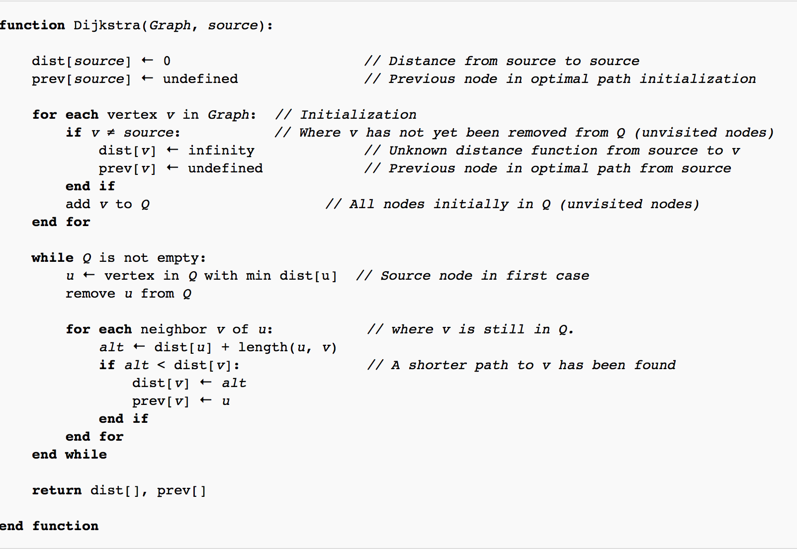
Dijsktra’s Shortest Path Algorithm
Source: https://en.wikipedia.org/wiki/Dijkstra%27s_algorithm

Slide 47
Importance of Efficiency
Computers have finite speed, finite memory.
Need to minimize amount of computation that the machines needs to make.
Algorithm X executes in 10n² + n / 3.7 + 22 steps
Algorithm Y executes in 100n log n + 14n + 22 steps
Which algorithm is better?
www.variability.org

Slide 48
Θ-notation
for i = 0 to n
a = a + 1
for i = 0 to n
for j = 0 to n
a = a + 1
Θ(n)
Θ(n²)
Algorithm X executes in 10n² + n / 3.7 + 22 steps → Θ(n²)
Algorithm Y executes in 100n log n + 14n + 22 steps → Θ(n log n)
Which algorithm is better?
Algorithm Y
Notes:
e limiting behavior of a function when the argument tends towards a particular value or infinity

Slide 49
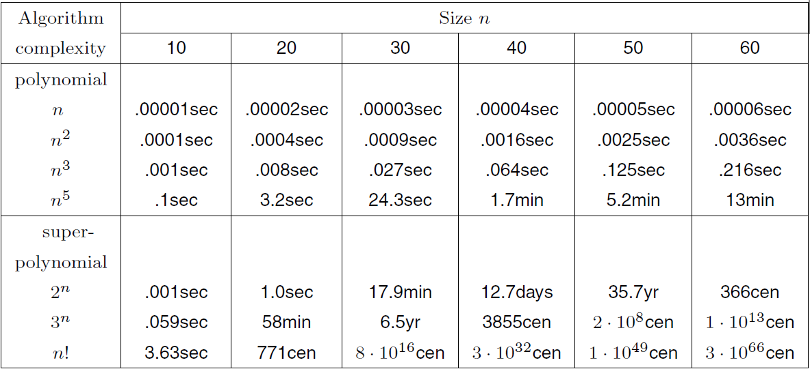
Running Time Comparison
Good
Bad!

Slide 50
Sorting Algorithms
Sorting is a fundamental operation in computer science and algorithms
Many algorithms use it as an intermediate step
There are several sorting algorithms, differing in their efficiency.

Slide 51
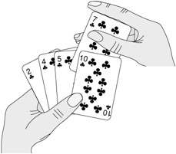
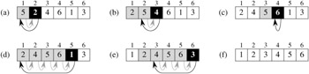
Insertion Sort
Start with empty left hand
Pick one card at a time
Insert it into the correct position in left hand
To find correct position, compare it with each of the cards already in hand

Slide 52
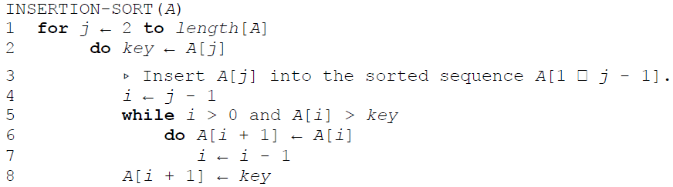
Insertion Sort

Slide 53
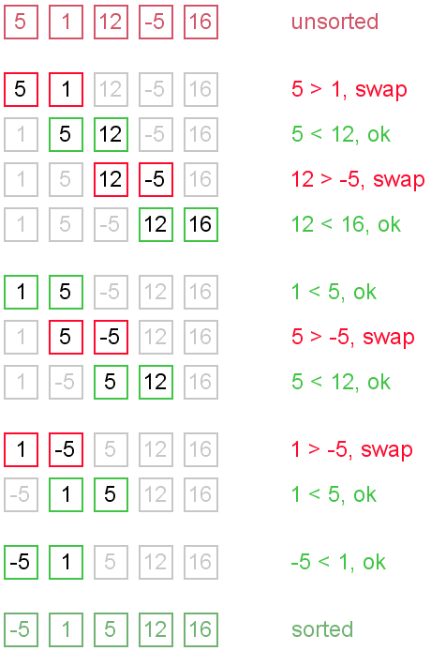
Bubble Sort
Go through the list:
If the next element is smaller:
SWAP!
www.variability.org

Slide 54
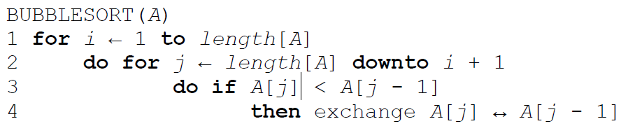
Bubble Sort

Slide 55
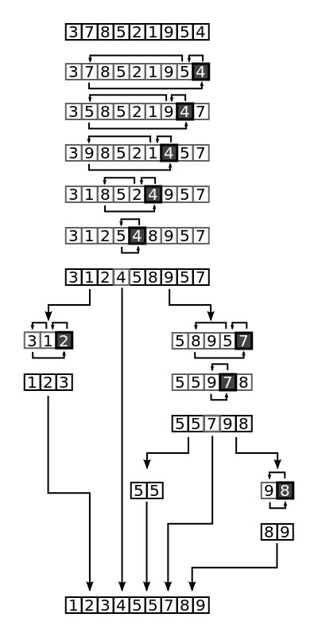
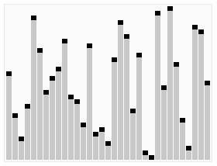
Quick Sort
Divide and conquer approach:
Pick an element from the list
Move elements smaller than the element before it
Move elements greater than it after it
Repeat for sub-problems
Animation and example from https://en.wikipedia.org/wiki/Quicksort
www.variability.org

Slide 56
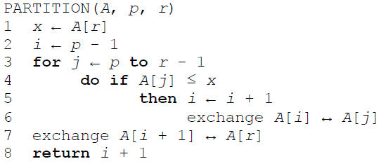
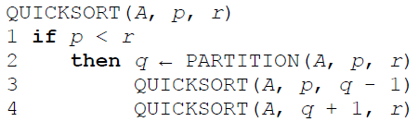
Quicksort
www.variability.org

Slide 57
Exercise: Bubble sort and comparison to Python sorting algorithm
Download material from https://www.dropbox.com/s/qgf7a7khdn60fb6/Sorting%20Example.zip?dl=0
We are using a simple graphics library. The graphical user interface does not work well with Spyder. So let’s run python from the command line as follows:
Windows: Open “cmd”. OS X: Open terminal
Type: cd <path to the sorting code>
Type: python bubble_sort_orig.py
Write in python Bubble Sort Algorithm
bubble_sort_orig.py: write your bubble sort function here
Speed:
Python has a sort function, that does not use Bubble sort.
We want to run both algorithms (our Bubble sort and Python sort), on different list sizes (6000: 26000 in increments of 2000) . In each run, we measure the runtime.
Add your bubble sorting code to sortBenchMark.py
Plot on a graph, the runtime of Bubble sort and Python sort for each size of list. Let’s see how the runtime increases as the size of the list increases.
www.variability.org

Slide 58
Algorithmic Techniques
Brute-force algorithms
Take the most direct or obvious solution approach
Enumerate all possible candidate solutions
Divide-and-conquer algorithms
break problem down into sub-problems that similar to the original problem, but smaller in size
Typically leads to recursive algorithms
E.g., MERGESORT
Greedy algorithms
Often applied to optimization problems involving a sequence of choices
At each step, the locally optimal choice is made
Dynamic programming algorithms
Break problem down into sub-problems
Use the solutions to these sub-problems to solve larger sub-problems (reusing results)

Slide 59
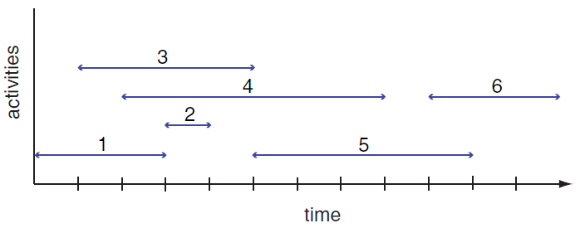
Greedy Algorithm
Activity Selection Problem
Given: A set of proposed activities that wish to use a resource, which can only be used by one activity at a time
Problem: Find maximum-size set of activities that do not have a time conflict

Slide 60
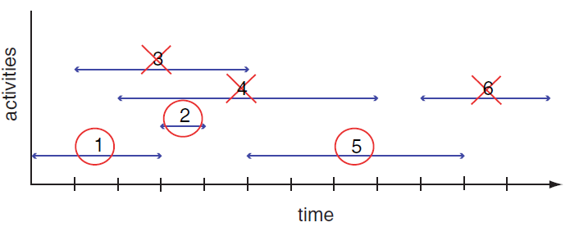
Greedy Algorithm
Greedy choice: Pick the remaining compatible activity that has the earliest finish time
Can you write an algorithm that does this?
Notes:
Tasks ordered by finish time

Slide 61
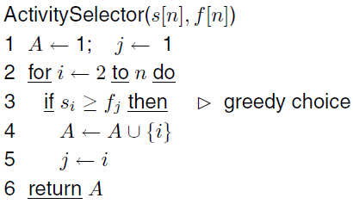
Algorithm for Activity Selection Problem
What is the running time for this algorithm?

Slide 62
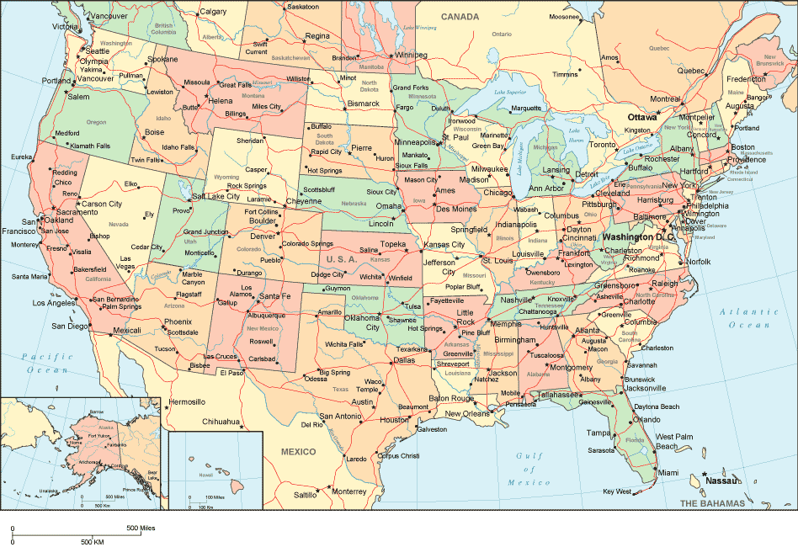
Traveling Salesman Problem
Given a list of cities and their pairwise distances,
find the shortest possible route that visits each city exactly once and returns to the origin city
How would you tackle this problem?

Slide 63
Mini-project: Obama’s travel plan in Python
Think of a good algorithm to reduce the cost of Mr. Obama’s trip
Mr. Obama wants to visit 52 cities
Travel cost= air fuel cost * distance
Air fuel consumption rate= 5 gallons per mile (estimate for a Boeing 747)
Implement your algorithm in the python function provided
Edit the traveler_orig.py
You are provided a function get_distance() to calculate distance between two locations.
Prepare 2-3 slides describing your strategy and your final solution and total distance
Can we solve it optimally?
Optional: Due to weather conditions, direct flights between some pairs of states are not possible.
Find a generic solution
As an example: these direct flights are blocked:
Austin, TX – Miami,FL
Washington D.C. – Baltimore, MD
Ann Arbor, MI – St Louis, MO
Vancouver, BC –Raleigh-NC
Atlanta, GA – Miami, Fl
www.variability.org

Slide 64
Mini-project: Obama’s travel plan in Python
Download code from
https://www.dropbox.com/s/fwj6dd1kz3p2wgh/TravellingSalesmanMiniProject.zip?dl=0
Submit code and slides by 3:00 pm on Thursday on Dropbox:
https://www.dropbox.com/request/XO9kYIx1mVaLtCMcdB7r
www.variability.org

Slide 65
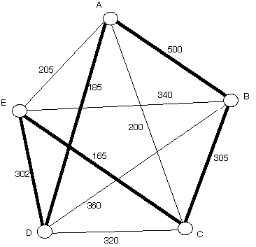
Nearest Neighbor Algorithm
Start at a vertex
Find the lightest edge connecting the current vertex and an unvisited vertex V
Set current vertex to V
Mark V as visited
Terminate when all the vertices have been visited
Repeat from step 2
Example: Starts from Vertex A and returns
to starting point at the end
Path: A - D - E - C - B - A
www.variability.org

Slide 66
Deficiencies of Nearest Neighbor
Worst case: algorithm can result in a path much longer than the optimal path
Won’t work in case of incomplete graph
When some cities are not connected
Any ideas for a better algorithm?
www.variability.org
Notes:
https://web.tuke.sk/fei-cit/butka/hop/htsp.pdf

Slide 67
ADDITIONAL MATERIAL

Slide 68
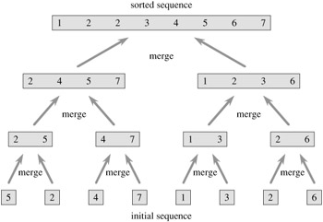
Merge Sort
Divide and conquer algorithm
Recursive algorithm
Split the list
Apply merge sort to the smaller list
After the smaller lists are collected: MERGE
(Note that each of the sublists is already sorted)
www.variability.org

Slide 69
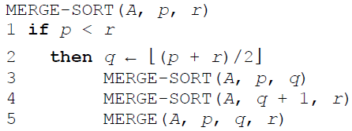
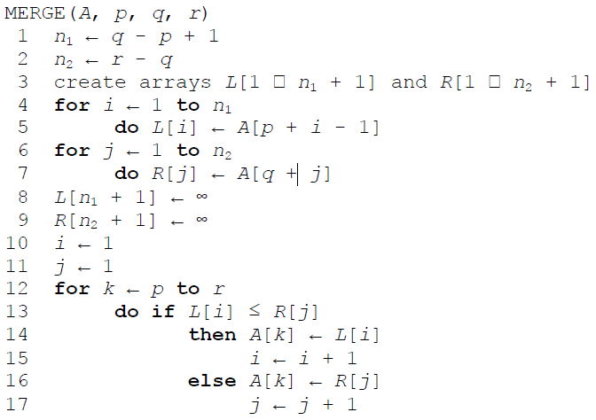
Mergesort
www.variability.org

Slide 70
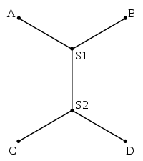
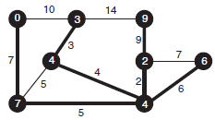
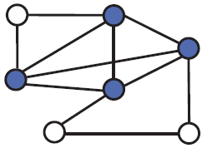
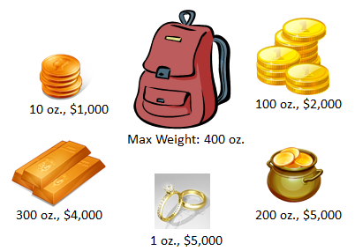
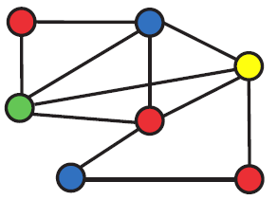


Optional Assignments
Karinna
Look into the following Algorithms
(1) Minimum spanning tree
(3) Graph coloring problem
(4) Graph partitioning problem
(2) Minimum Steiner tree
(4) Maximum Clique
problem
(6) Knapsack problem
(7) Towers of Hanoi

Slide 71

Graph Exercises
Graphs - nearest neighbor algorithm
http://nodebox.net/code/index.php/Graph
www.variability.org

